Slide 1


Nicolas MARAIS
27/01/2022

Slide 2

Outline
Executive Summary
Introduction
Methodology
Results
Conclusion
Appendix

Slide 3
Executive Summary
In order to provide a thorough analysis, we proceeded steps by steps: starting from Data Collection using SpaceX API and Web Scrapping to Data Wrangling to get a glimpse of the data. Then we achieved Exploratory Data Analysis (EDA) with Data Visualization (plots) and SQL. Next was building an interactive Map with Folium to highlights key information about launches and sites. Visualizing key data about launch sites and Payload was achieved thanks to building a Dashboard with Plotly Dash. Eventually, we compared and built a predictive classification model based on the datasets at our disposal.
After computing all gathered data and insights we can consider a list of potential commercial orbits such as ISS, LEO, SSO, VLEO and GTO from an eastern launch site (KSC and/or CCAFS) and PO from a western launch site (VAFB). Along with these orbits, multiple booster versions can be considered depending on the payload: FT, B4, Heavy. We also recommend a further analysis about the Falcon 9 Block 5 that has shown promising performances on late SpaceX launches.

Slide 4
Introduction
Space Y is the newest sub-orbital and orbital reusable rockets manufacturer founded by Allon Mask.
Space Y wants to provide competitive launches and bid against the actual leader, Space X.
In order to achieve our goals, we plan on reusing Falcon 9 stage 1 rockets to minimize our overall launch costs using Data Science and Machine Learning models.
Therefore, we need to be able to assess :
Which parameters are relevant to a successful landing.
If a rocket will be land successfully or not.

Slide 5


Slide 6
Methodology
Executive Summary
Data collection methodology:
Describe how data was collected
Perform data wrangling
Describe how data was processed
Perform exploratory data analysis (EDA) using visualization and SQL
Perform interactive visual analytics using Folium and Plotly Dash
Perform predictive analysis using classification models
How to build, tune, evaluate classification models

Slide 7
Data Collection
Data sets were collected using 2 methods : SpaceX API and Web scrapping
To collect data from a distant source, you need to call upon an interface (API or Library) that will interact with the data source
Application
Interface
Data Source

Slide 8
Data Collection – SpaceX API
The notebook makes a get request to SpaceX API (= API Call)
SpaceX API performs the get request to SpaceX Web Service/Server that sends back data
SpaceX API formats the data into a Json file and forwards the result to the notebook
GitHub URL of the completed SpaceX API calls notebook
Notebook
SpaceX API
SpaceX Web Service/Server
API Call
Get
Json file
Data

Slide 9
Data Collection - Scraping
The notebook call upon the Requests library to execute a get method
The Requests execute the get() toward the Wikipedia Server that send back the Webpage as text file
The Requests library makes the text file available for the notebook to be used
GitHub URL of web scraping notebook
Requests Library
Wikipedia Web Page/Server
Notebook
Request
Get
Answer
Text file

Slide 10
Data Wrangling
In order to gain knowledge about the data set we ran some checks :
Null values : there was no null values to handle before going any further
Data Types (columns.dtypes) : which column is numerical or categorical
Now that we have a rough idea about our data set, let's take a look at a few data:
Number of launches for each site
Number of launches for each type of orbit
Number of each type of outcome
Create a "Class" column that tells if the landing outcome is a success (1) or a failure (0)
GitHub URL of Data Wrangling related notebook

Slide 11
EDA with Data Visualization
Scatter plot of Flight Number vs Launch site to figure out the repartition of all fight between all sites and the success rate's progression over time
Scatter plot of Launch site vs Payload Mass to observe how the payload is distribute between sites
Bar chart of Orbit vs Success Rate to compare every orbit success rate against each other
Scatter plot of Flight Number vs Orbit to observe the advancement of success rate over time per orbit
Scatter plot of Payload Mass vs Orbit to determine which payload correspond to which orbit
Line chart of the success rate vs Years to evaluate the progression of the global success rate over the year
GitHub URL of EDA with data visualization notebook

Slide 12
EDA with SQL
List of SQL queries objectives :
Select all launch site names
Select 5 launch site names that begin with 'CCA'
Count the total Payload Mass
Calculate the Average Payload Mass for F9 v1.1
Select the date of the 1st successful Ground Landing
Select the booster version for successful Drone ship landing with a Payload Mass between 4000 and 6000
Count the total number of Successful/Failure outcome
Select the booster versions that carried the Max Payload Mass
Select all 2015 failure records for Drone Ship landing
Rank all landing outcomes from 2010-06-04 to 2017-03-02
GitHub URL of EDA with SQL notebook

Slide 13
Build an Interactive Map with Folium
A various number of map objects have been added to a Folium Map in order to highlight geographical characteristics:
Marker : used to visualize notorious location such as launch sites, cities, highways, trainrails, coastline, point of interest, etc
Circle : used to highlight a specific area (the area around each launch site in our case)
Cluster : used to group together outcome markers as there are really close to each other, we linked them to their relative launch site
Line : Highlights distance between a given site and neighboring cities, highways, coastline, touristic sites, etc.
GitHub URL of Interactive Map with Folium map notebook

Slide 14
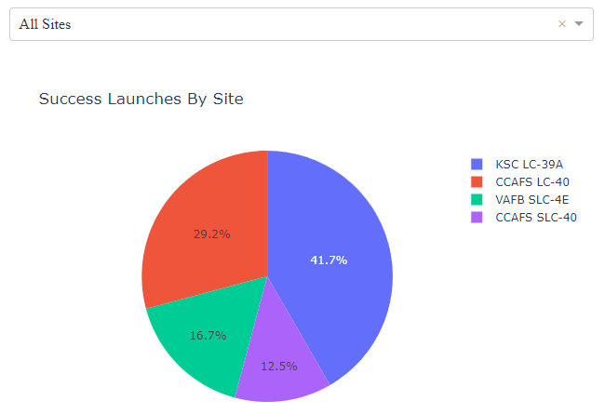
Build a Dashboard with Plotly Dash
We use a pie chart to visualize the success launches by site either :
All successful launches against all sites
Ratio success/failure by site
We can select all or a specific site with the dropdown menu
GitHub URL of the interactive visual Plotly Dash file

Slide 15
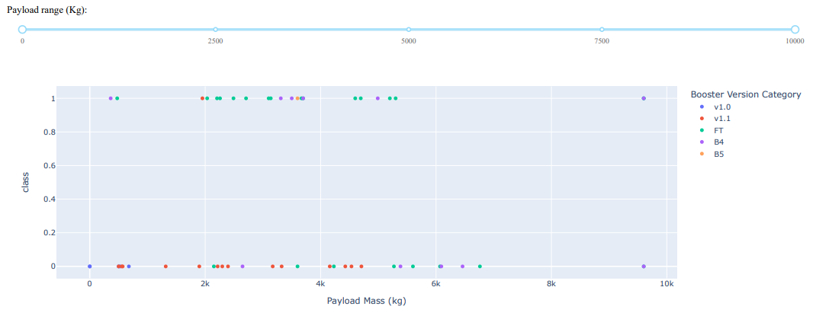
Build a Dashboard with Plotly Dash
A scatter plot is used to observe the outcome of each launch depending on the payload mass and the booster version
A slider is used to custom the range payload mass we want to visualize (from 0 to 10k KG)
Source code file of the interactive visual Plotly Dash

Slide 16
Predictive Analysis (Classification)
We used GridSearchCV from scikit-learn library to build, evaluate and improve multiple models and choose the best performing one out of them
We input a model with parameters (like metrics and cv folds) and GridSearchCV returns a fitted model with the best parameters and score to us.
GridSearchCV will train the given model by iterating the initial parameters n times (=cv folds) then select the best parameter by the given metrics and train the model with it before returning the result.
GitHub URL of the predictive analysis lab
GridSearchCV
Train
Model Parameters
Evaluate
Trained Model
Best Parameters
Yes
Next Parameter ?
No
Train with Best Parameters
Accuracy

Slide 17
Results
Exploratory data analysis results
Interactive analytics demo in screenshots
Predictive analysis results

Slide 18


Slide 19
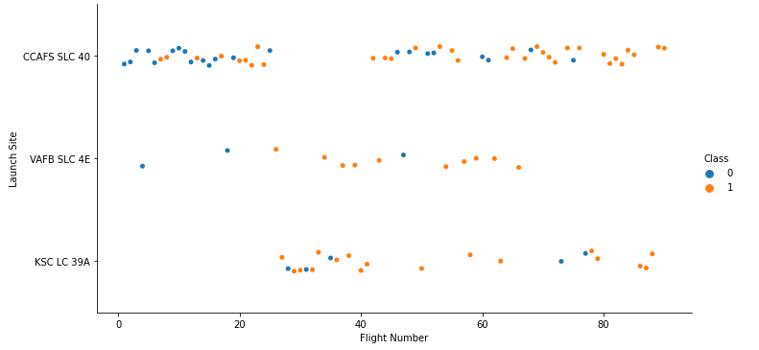
Flight Number vs. Launch Site
The first flight occurred from CCAFS SLC-40, this site has higher launch count than the other 2 sites.
VAFB SCL-4E has the lower number and frequency of flights then its circumstances might be special.
KSC LC-39A was the last site used and we can observe that it seems to be used alternately with CCAFS SLC-40.
The success rate increases with the number of launches therefore built-up experience increases the success rate

Slide 20
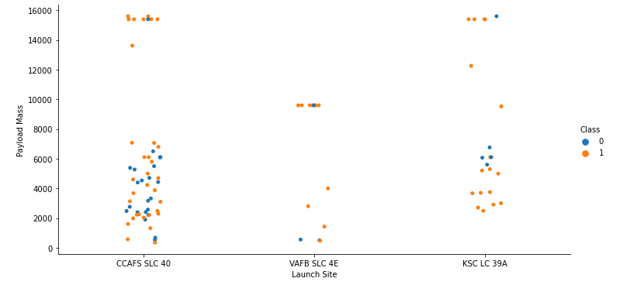
Payload vs. Launch Site
There is no launches for heavy payload mass ( > 10k KG) from VAFB SLC 4E site.
We can note that heavy payload launches tends to have a better success rate that lighter payload launches.

Slide 21
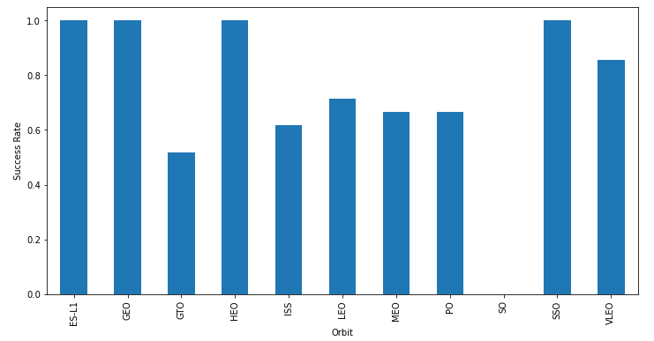
Success Rate vs. Orbit Type
During data wrangling, we noted that ES-L1, HED, SO and GEO have performed only one launch each, we would need more data to make sure the outcomes are relevant to the orbit
The success rate is mostly over 60%, except for GTO

Slide 22
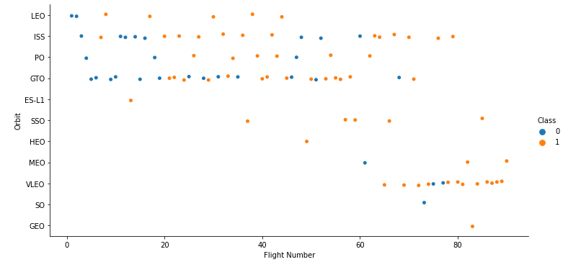
Flight Number vs. Orbit Type
LEO orbit success appears related to the number of flights, as for PO and MEO orbits.
There seems to be no relationship between flight number when it comes to GTO, ISS or VLEO orbits.

Slide 23
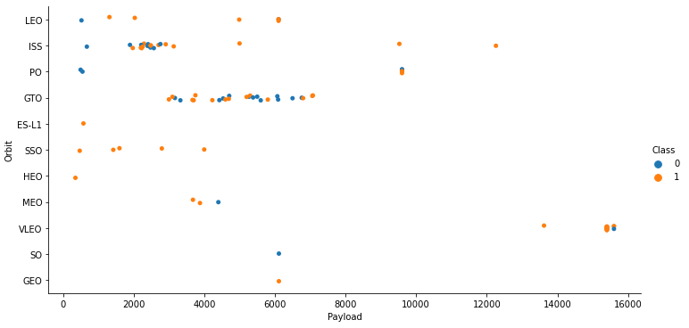
Payload vs. Orbit Type
ISS, PO and VLEO orbits appears to have a better success rate with heavy payloads
GTO orbit success rate appears to have no relationship with the payload mass

Slide 24
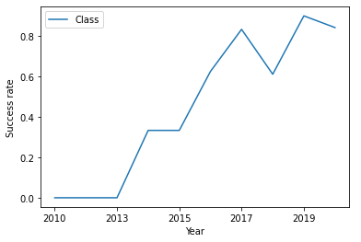
Launch Success Yearly Trend
From 2013 to 2020, the overall success rate improved even if we can note 2 slight steps back (2018 and 2020)

Slide 25
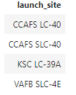
All Launch Site Names
SELECT DISTINCT statement returns only different values (no duplicate)

Slide 26
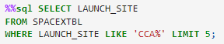
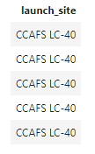
Launch Site Names Begin with 'CCA'
In a WHERE Clause, we use LIKE to compare strings and LIMIT 5 to fetch only 5 results

Slide 27
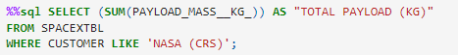
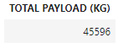
Total Payload Mass
The SUM function allows us to sum the values of a given column, the WHERE clause on the CUSTOMER column acts as a filter

Slide 28
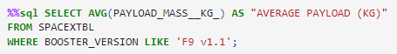
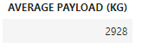
Average Payload Mass by F9 v1.1
The AVG function calculate the average value of a give column and the WHERE clause on the BOOSTER_VERSION column act as a filter for the given value

Slide 29
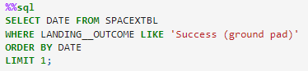
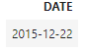
First Successful Ground Landing Date
The ORDER BY keyword is used to sort result-set (ascending order by default), the WHERE clause is used as a filter. LIMIT 1 is used to fetch only the 1st row.

Slide 30
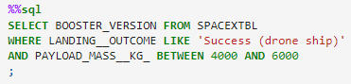
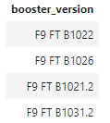
Successful Drone Ship Landing with Payload between 4000 and 6000
The WHERE clause is used as a filter for both LANDING__OUTCOME and PAYLOAD, with the keyword BETWEEN to specify the desired range.

Slide 31
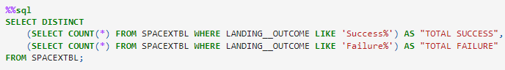
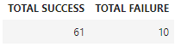
Total Number of Successful and Failure Mission Outcomes
To calculate each value, we need to do a subquery using the COUNT function and a WHERE clause to filter each LANDING__OUTCOME state. A SELECT DISTINCT statement is used to return only pairs of different values (= 1 row)

Slide 32
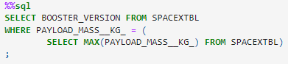
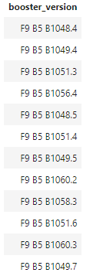
Boosters Carried Maximum Payload
In order to apply a filter using the WHERE clause, we need to use a subquery with the MAX function inside the WHERE clause to get the highest value for the PAYLOAD_MASS__KG_ column

Slide 33
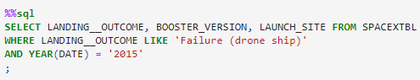
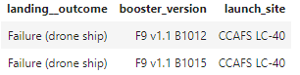
2015 Launch Records
The WHERE clause is used to filter both LANDING__OUTCOME and DATE. We apply the YEAR function on the date column to use only the year as a filter parameter

Slide 34
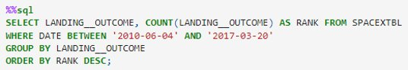
Rank Landing Outcomes Between 2010-06-04 and 2017-03-20
The COUNT function is used on LANDING__OUTCOME which is named RANK
The WHERE clause with the BETWEEN keyword apply a filter on a range of dates
The GROUP BY keyword aggregate the result set and the ORDER BY keyword is used with DESC

Slide 35
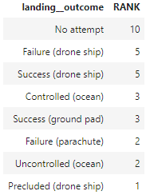
Rank Landing Outcomes Between 2010-06-04 and 2017-03-20

Slide 36


Slide 37
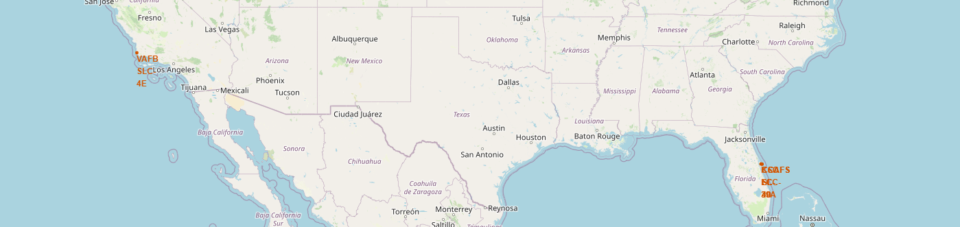
SpaceX Launch Sites Location Map
All launch sites are located near coastlines and in region with clear weather as it is a major parameter for a successful launch
There are 2 sites on the eastern coast of Florida to use the Earth speed rotation at their advantage (easterly launches)
There is 1 site on the coast of California that is used to launch rocket onto Polar orbits (southerly launches)
Please note that CCAFS SLC-40 is the same as CCAFS SLC-40 that has been renamed. Therefore I counted it as 1 site.

Slide 38
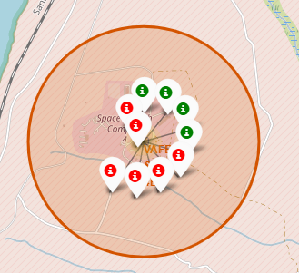
Launch Outcomes Map
The map highlights all launch outcomes for each site
Using the clustering feature from Folium, we placed green markers (success) and red markers (failure) for each launch to their respective launch site

Slide 39
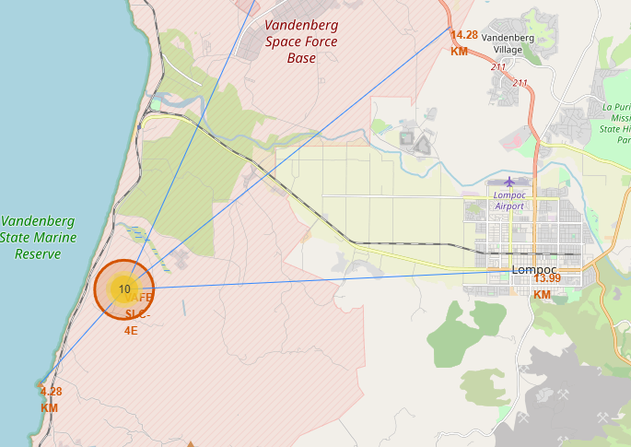
Points of Interest proximity Map
Launch sites are away from any non-essential launching facilities and buildings : Highways, Cities, Railways
They are close to coastlines to limit any possible damage/danger to hinterlands due to failures.
Launches are oriented toward water bodies.

Slide 40


Slide 41
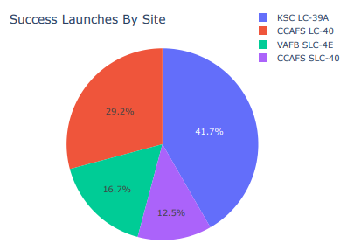
Launch Success by site
We observe the repartition of the successful launches by site
From this pie chart, KSC LC-39A appears to have the highest success rate
If we take into consideration that the CCAFS LC-40 and SLC-40 are the same site that has been renamed, it has the same success rate as KSC LC-39A (41.7%)
Furthermore, SLC-4E site that is located on the Californian coast has the lowest success rate (Polar Orbit launches)

Slide 42
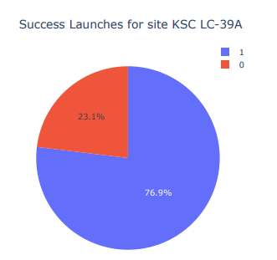
Launch outcomes for KSC LC-39A
KSC LC-39A has the best success ratio among all sites
According to this pie chart, almost 77% of launches that happen at Kennedy Space Center are concluded by a successful landing of the rocket.

Slide 43
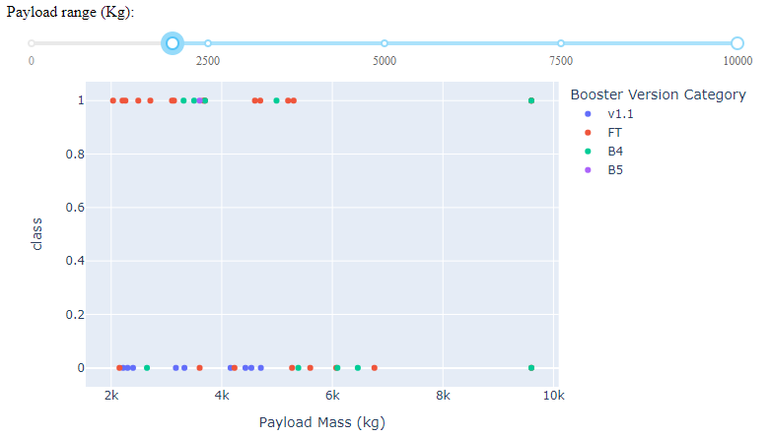
Relationship between Payload Mass and Booster Version
As we can observe in Figures 1, 2 (slide 44) and 3 (slide 44):
V1.1 booster version has no record of a successful landing with the selected ranges
FT booster version has a high success rate with Payload < 5600 kg
Block 4 booster version has high success rate with Payload between 3000 and 5000 kg
Block 5 booster version has only 1 launch (success), that might be promising but we cannot conclude anything with only one record.
Figure 1

Slide 44
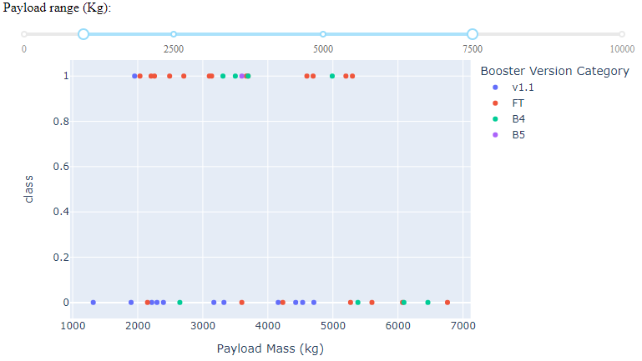
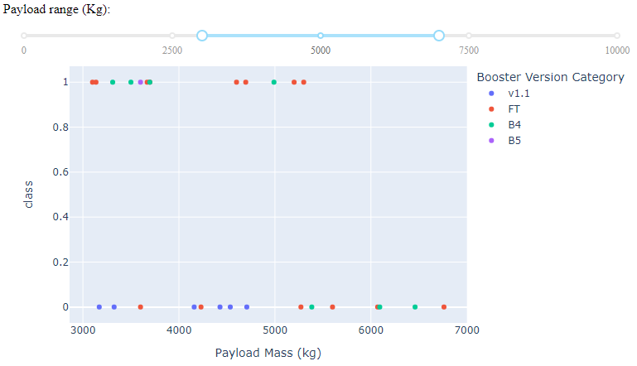
Relationship between Payload Mass and Booster Version
Figure 2
Figure 3

Slide 45


Slide 46
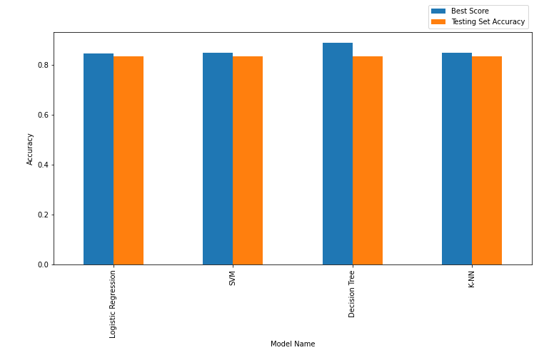
Classification Accuracy
We plotted the best score with the training set against the accuracy with the testing set, for each model
Even if the Decision Tree model is the best with the training set, all models have a similar accuracy with the testing set.

Slide 47
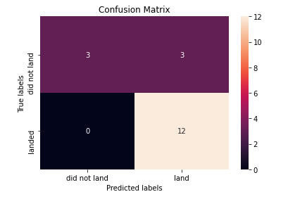
Confusion Matrix
Here is the confusion matrix for the Decision Tree model.
We observe that there is no False Positive then we can assume that each landing predicted by the model will be a success.
On the other hand, there are 3 False Negative results that might lead to waste rockets in situations where we could have safely landed them.

Slide 48
Conclusions
Depending on the type of orbit we need to reach, we must have at least 2 launch sites, one on the east coast (KSC or CCAFS) and the other on the west coast (VAFB) for Polar orbit launches.
In order to achieve a successful landing, we need to select the appropriate booster version according to the payload and the budget allowed to each launch :
FT for payload under 5,500Kg
B4 for payload between 3,000 and 5,000 kg
Heavy for payload over 10,000kg
B5 seems to have a really good reusable rate (up to 10 times) but we need to further investigate this specific version because it is the latest version used by SpaceX
Some orbits have a really low commercial potential due to the low demand (1 launch) : ESL1, HEO, SO and GEO
Orbits with the best commercial potential are : ISS, LEO, PO, SSO and VLEO due to their high success rate and a fair number of occurrences.
We did not identify the features that affect GTO orbit launches success rate (further investigations required) but it success rate is still over 60% and has a fair number of occurrences too, that stills qualify it for commercial uses.
In order to improve our decision making process, we need to collect more data about Flacon 9 Block 5 launches and to identify the estimated average reuse time for each booster version.

Slide 49
Appendix
All resources can be found online.
SpaceX Falcon 9 Wikipedia webpage: https://en.wikipedia.org/wiki/Falcon_9
All Hands-on Lab Notebooks GitHub repository: https://github.com/vahnorion/COURSEA_DS_CAPSTONE
Data Collection API Lab: https://github.com/vahnorion/COURSEA_DS_CAPSTONE/blob/master/Data%20Collection%20API%20Lab.ipynb
Data Collection Web Scrapping Lab: https://github.com/vahnorion/COURSEA_DS_CAPSTONE/blob/master/Web%20Scraping%20Lab.ipynb
Data Wrangling Lab: https://github.com/vahnorion/COURSEA_DS_CAPSTONE/blob/master/EDA%20Lab%20(Wrangling%20Data).ipynb
EDA with Visualization Lab: https://github.com/vahnorion/COURSEA_DS_CAPSTONE/blob/master/EDA%20with%20Visualization%20Lab.ipynb
EDA with SQL Lab: https://github.com/vahnorion/COURSEA_DS_CAPSTONE/blob/master/EDA%20with%20SQL%20Lab.ipynb
Interactive Visual Analytics with Folium (Map) Lab: https://github.com/vahnorion/COURSEA_DS_CAPSTONE/blob/master/Interactive%20Visual%20Analytics%20with%20Folium%20Lab.ipynb
Python file created for Interactive Dashboard with Plotly Dash: https://github.com/vahnorion/COURSEA_DS_CAPSTONE/blob/master/spacex_dash_app.py
Dataset used for Interactive Dashboard with Plotly Dash (provided by Coursea): https://github.com/vahnorion/COURSEA_DS_CAPSTONE/blob/master/spacex_launch_dash.csv
Repository of screenshots used in Interactive Dashboard with Plotly Dash : https://github.com/vahnorion/COURSEA_DS_CAPSTONE/tree/master/Dashboard%20states
Machine Learning Prediction Lab: https://github.com/vahnorion/COURSEA_DS_CAPSTONE/blob/master/Machine%20Learning%20Prediction%20Lab.ipynb
This Assignment: https://github.com/vahnorion/COURSEA_DS_CAPSTONE/blob/master/ds-capstone-template-coursera.pdf

Slide 50


